Slide 1
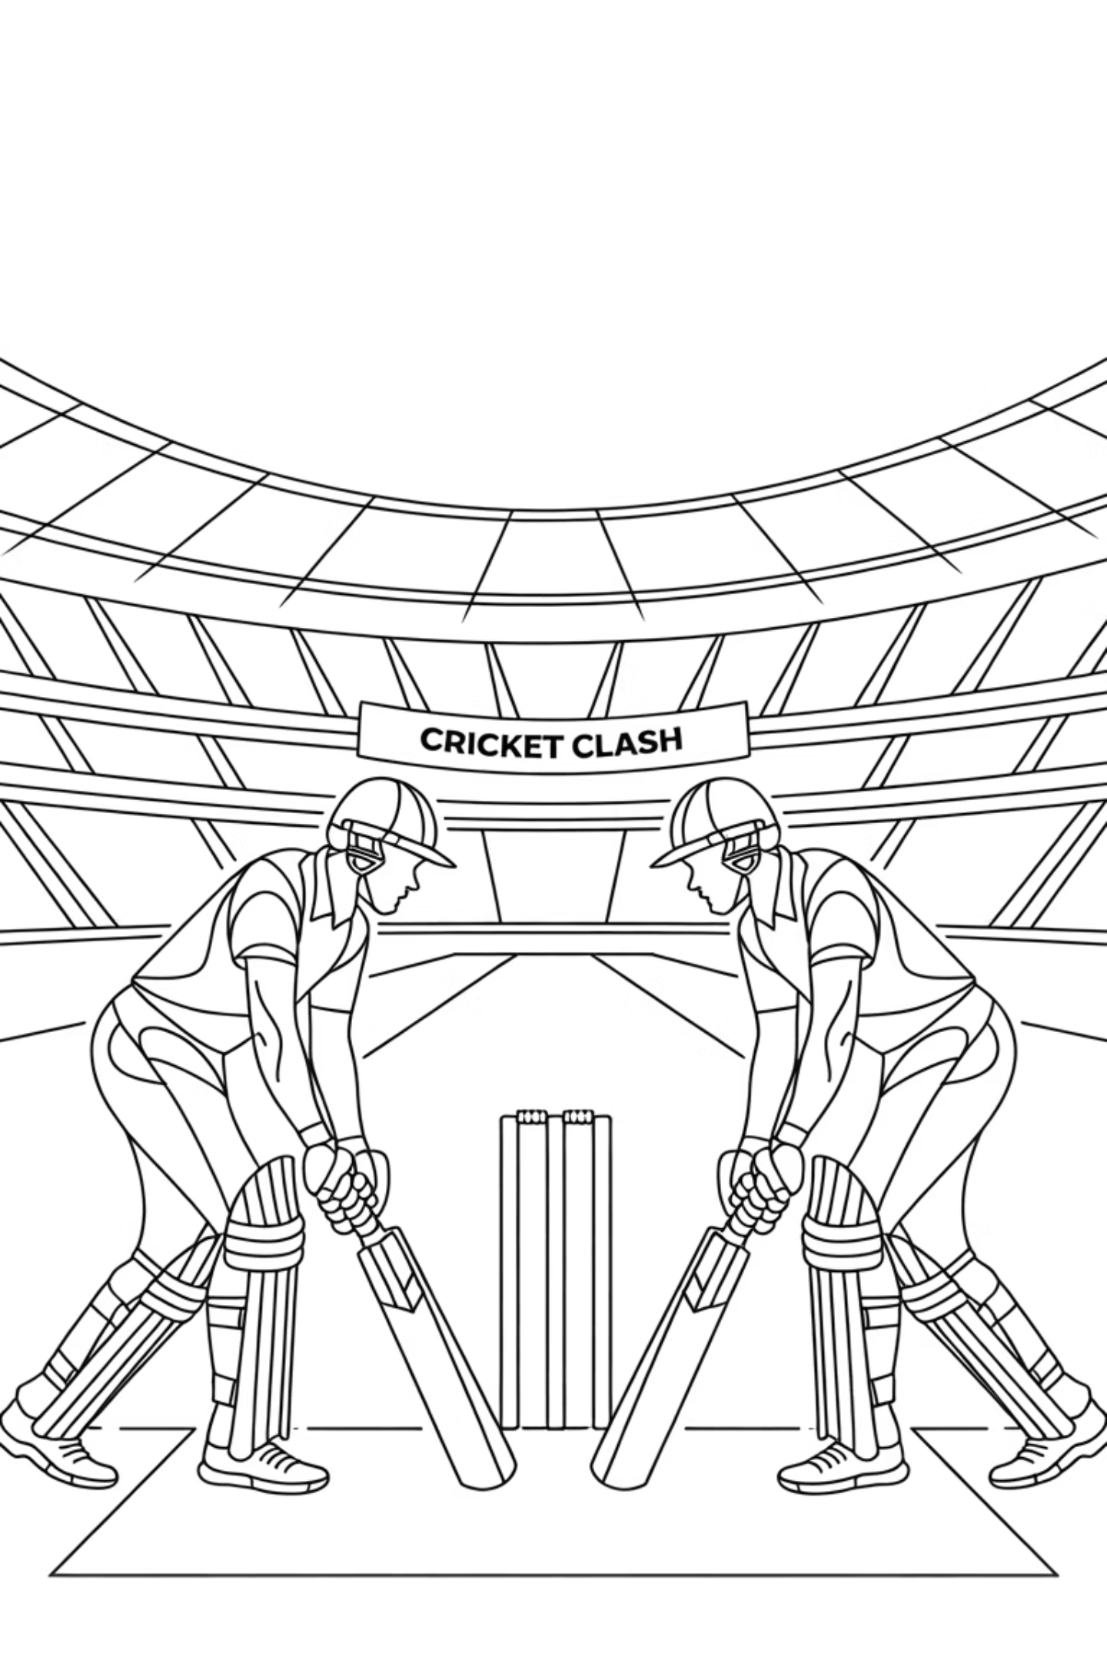
Android vs iOS War
Think of Android & iOS as two rival cricket teams. Both play the same game → but different styles. As Flutter devs, we must please BOTH audiences.
Story: "My first Flutter app looked perfect on Android… but on iPhone, it looked like an alien invasion. That's when I learned about design languages."

Slide 2
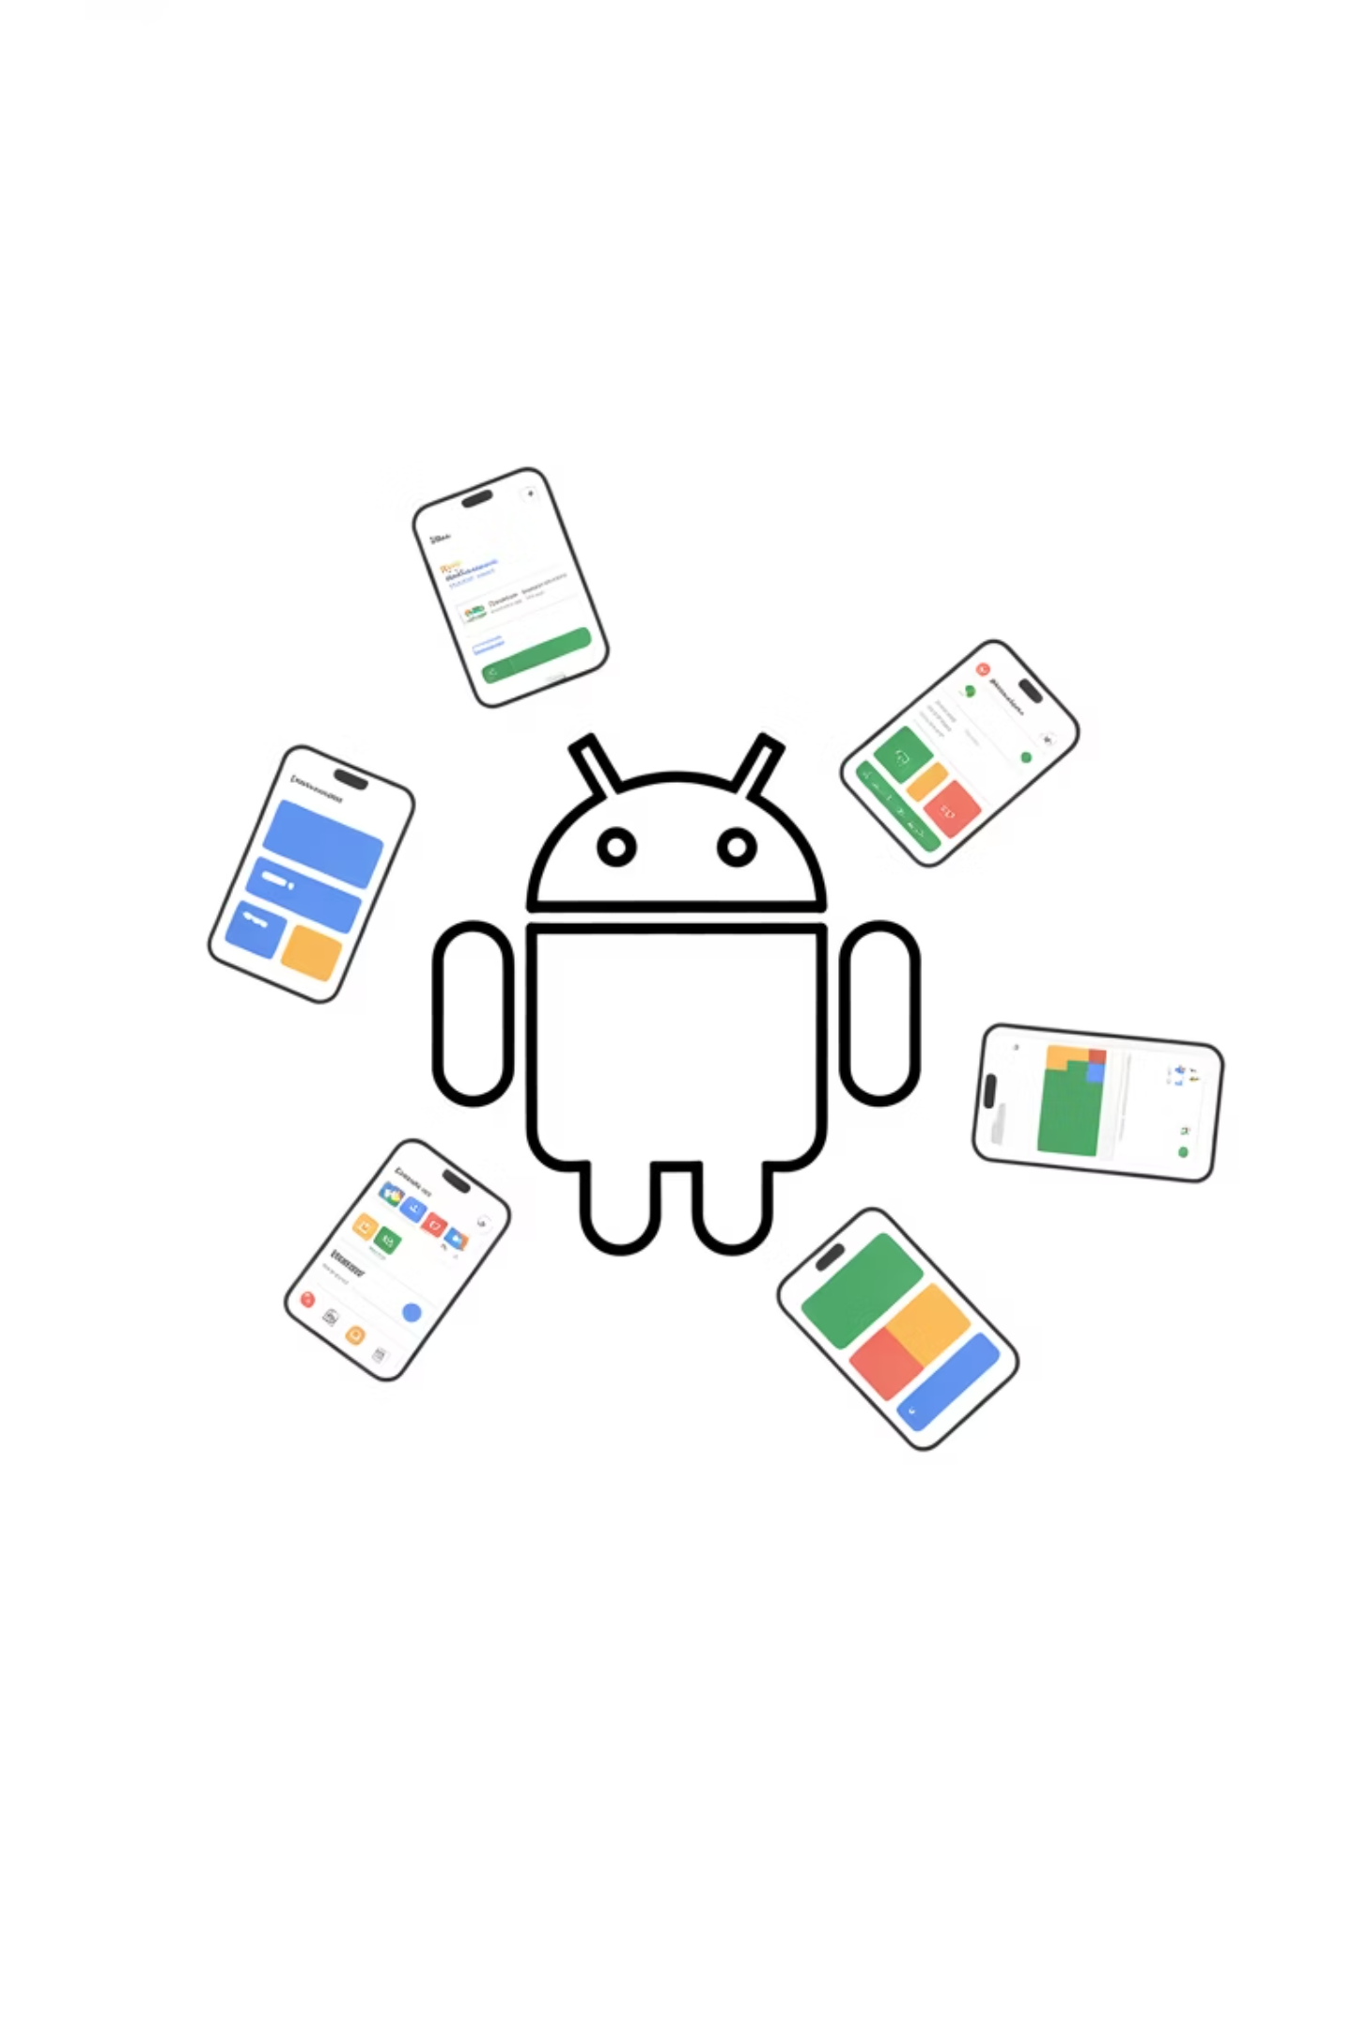
Android OS Basics
Developed by Google.
Open source, customizable.
Runs on thousands of device models.
Flutter Relevance: Your Android Flutter app must run on low-end & high-end phones (Samsung to Symphony).

Slide 3
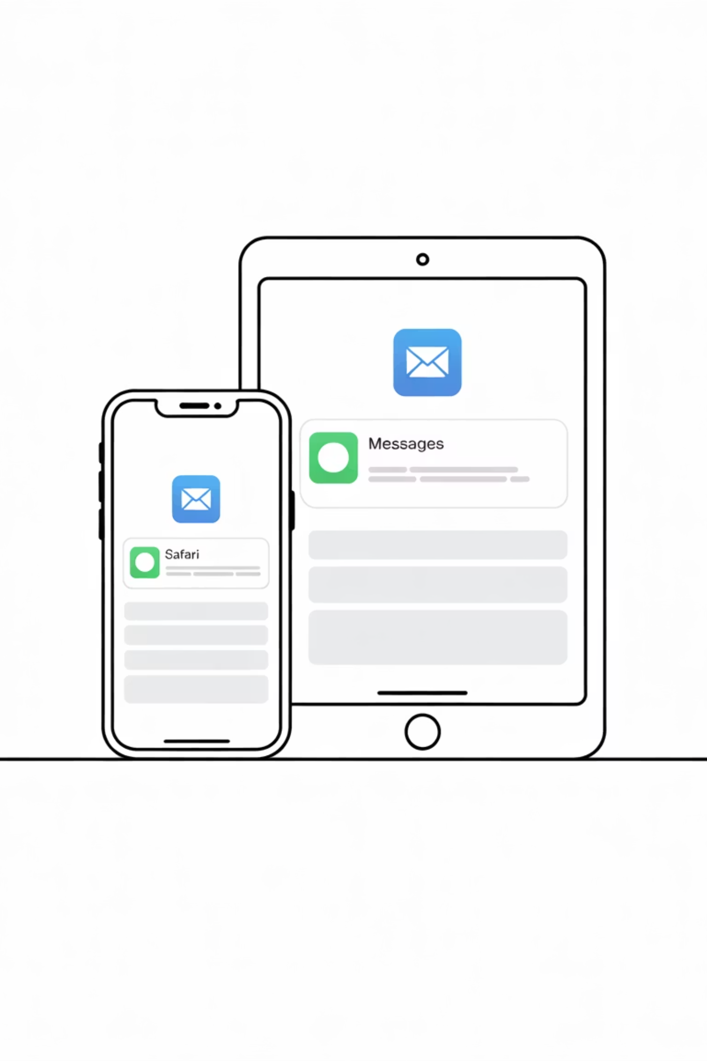
iOS OS Basics
Developed by Apple.
Closed, highly controlled.
Limited devices → iPhones, iPads only.
Flutter Relevance: Your iOS Flutter app must follow Apple's strict design & App Store rules.

Slide 4
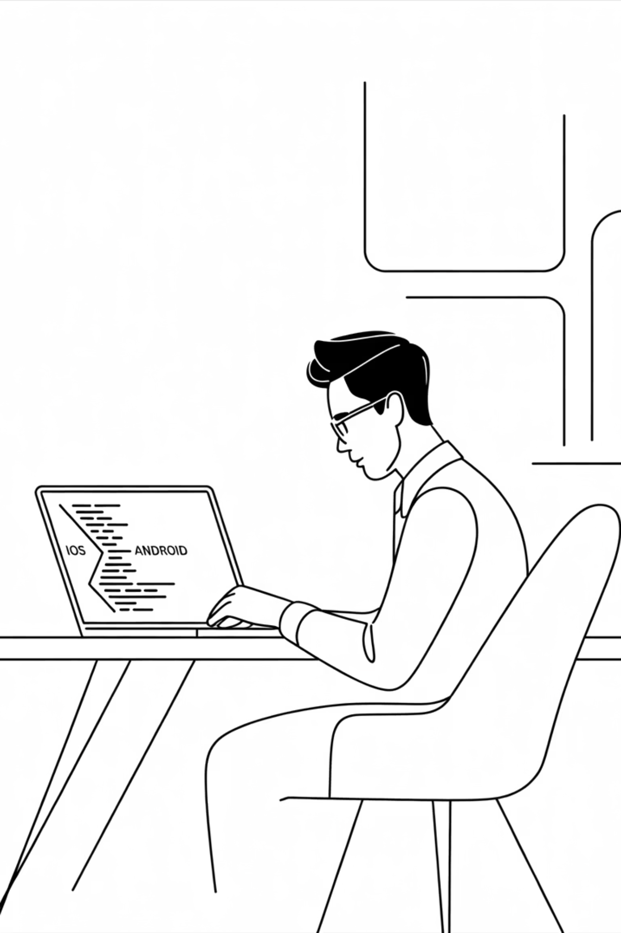
Why OS Matters for Flutter Devs
Flutter writes one codebase.
But Android & iOS handle UI & performance differently.
Example: Permissions (camera, storage) → Different flows.
Interactive: Ask: "Who here uses Android? Who uses iPhone? Which feels smoother to you?"

Slide 5
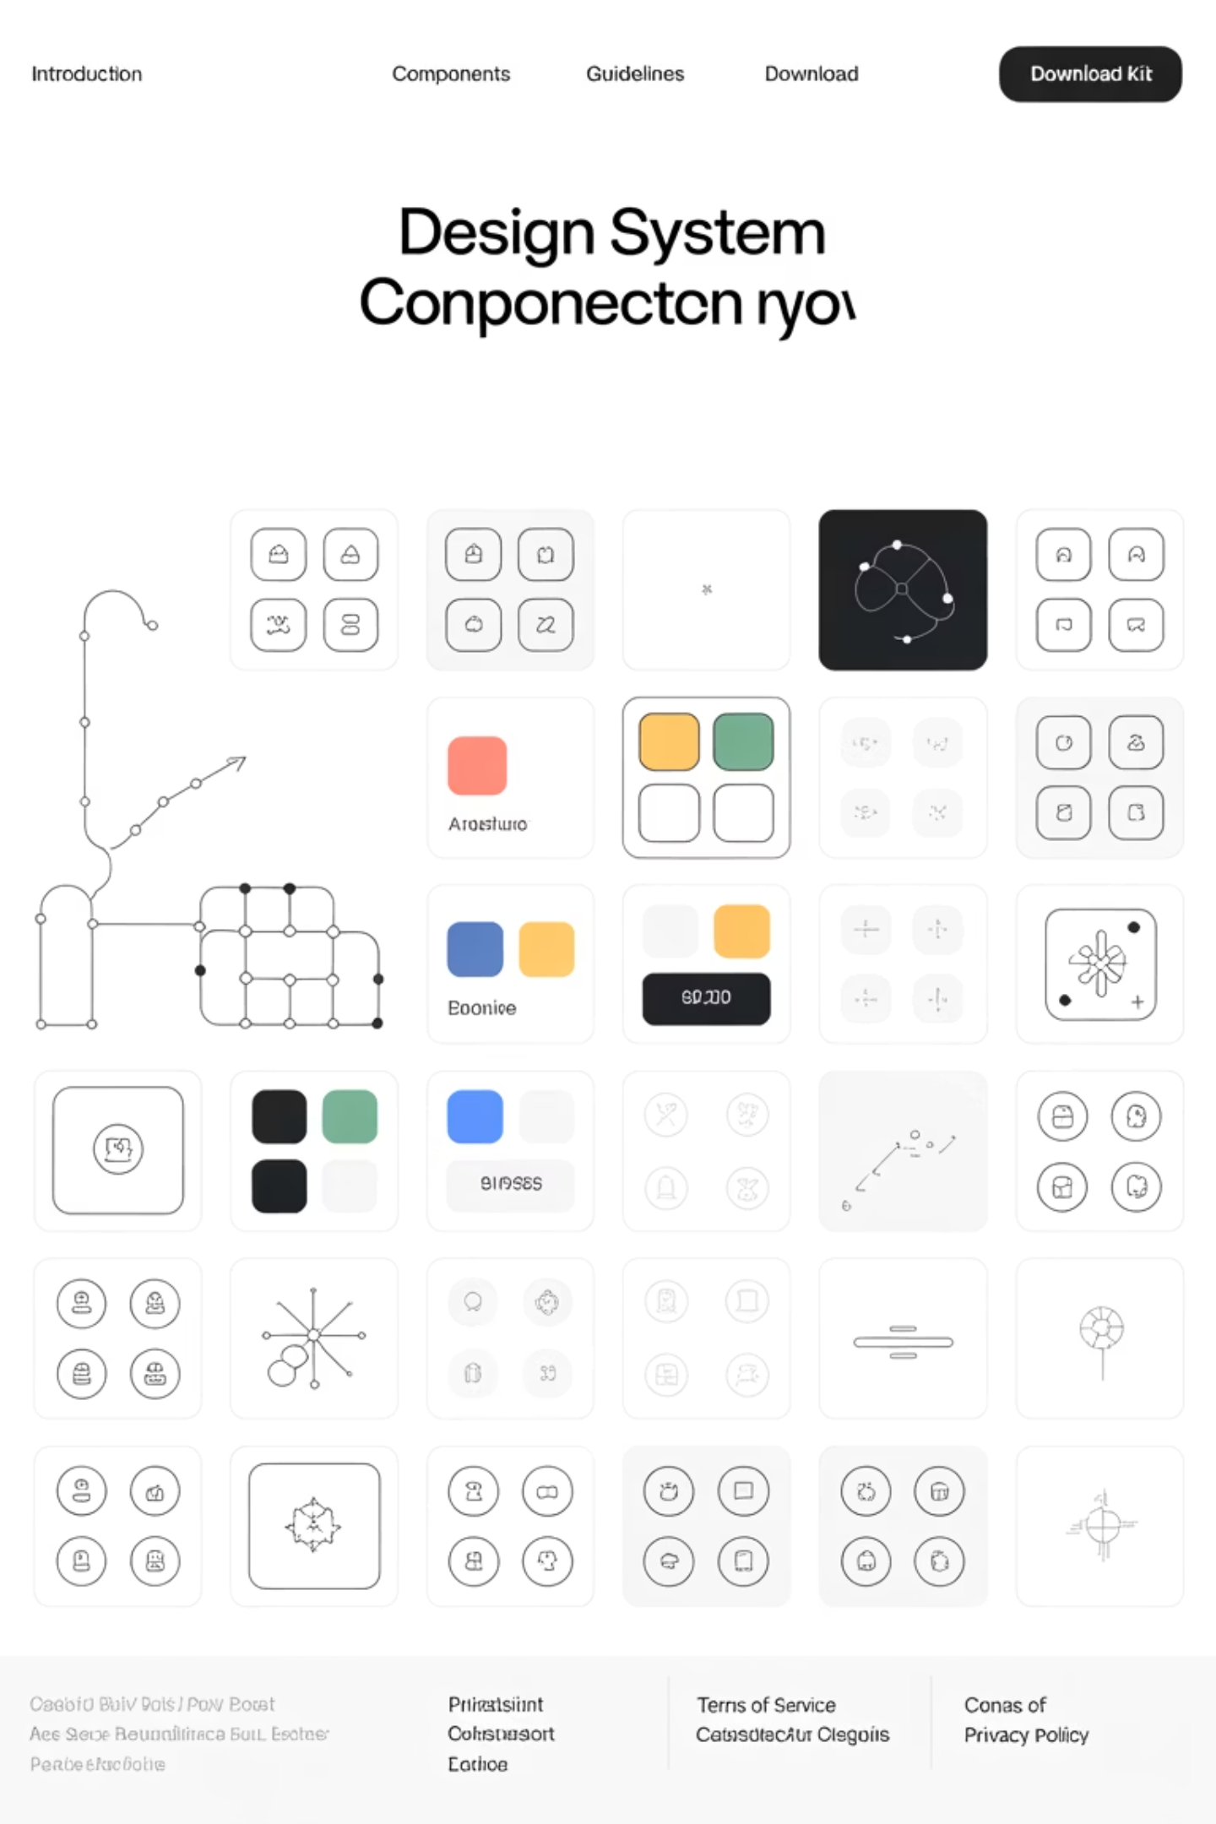
Design Language – What is It?
A set of rules that define how apps "look & feel."
Colors, buttons, animations, icons, spacing.
Without design language → apps feel messy & inconsistent.
Example: Imagine a Facebook app where buttons look different on Android vs iOS → confusing!

Slide 6
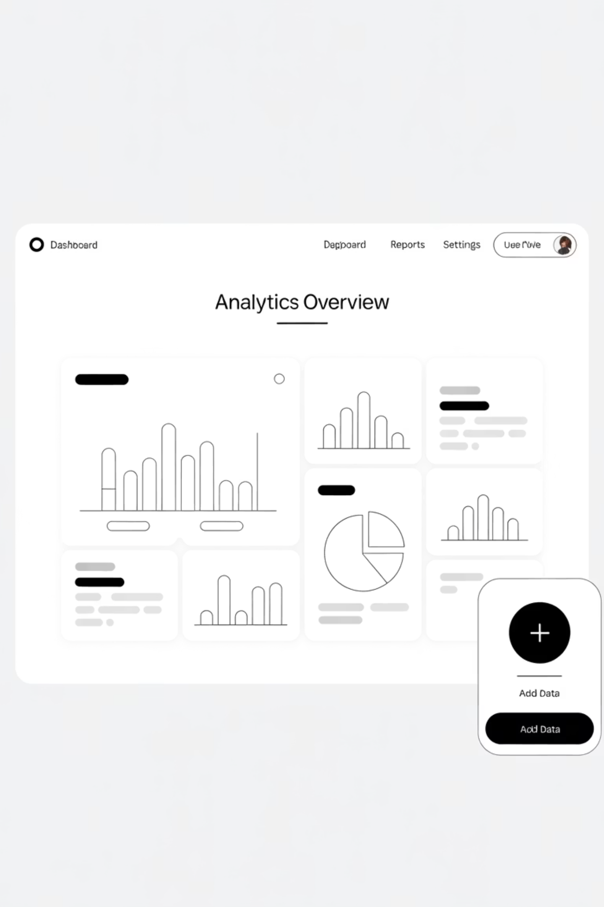
Material Design (Google's Language)
Born from Android.
Clean, bold, flat look.
Floating Action Buttons, Snackbars, Cards.
Flutter Relevance: Most Flutter widgets (Scaffold, AppBar, FAB) are built using Material design.

Slide 7
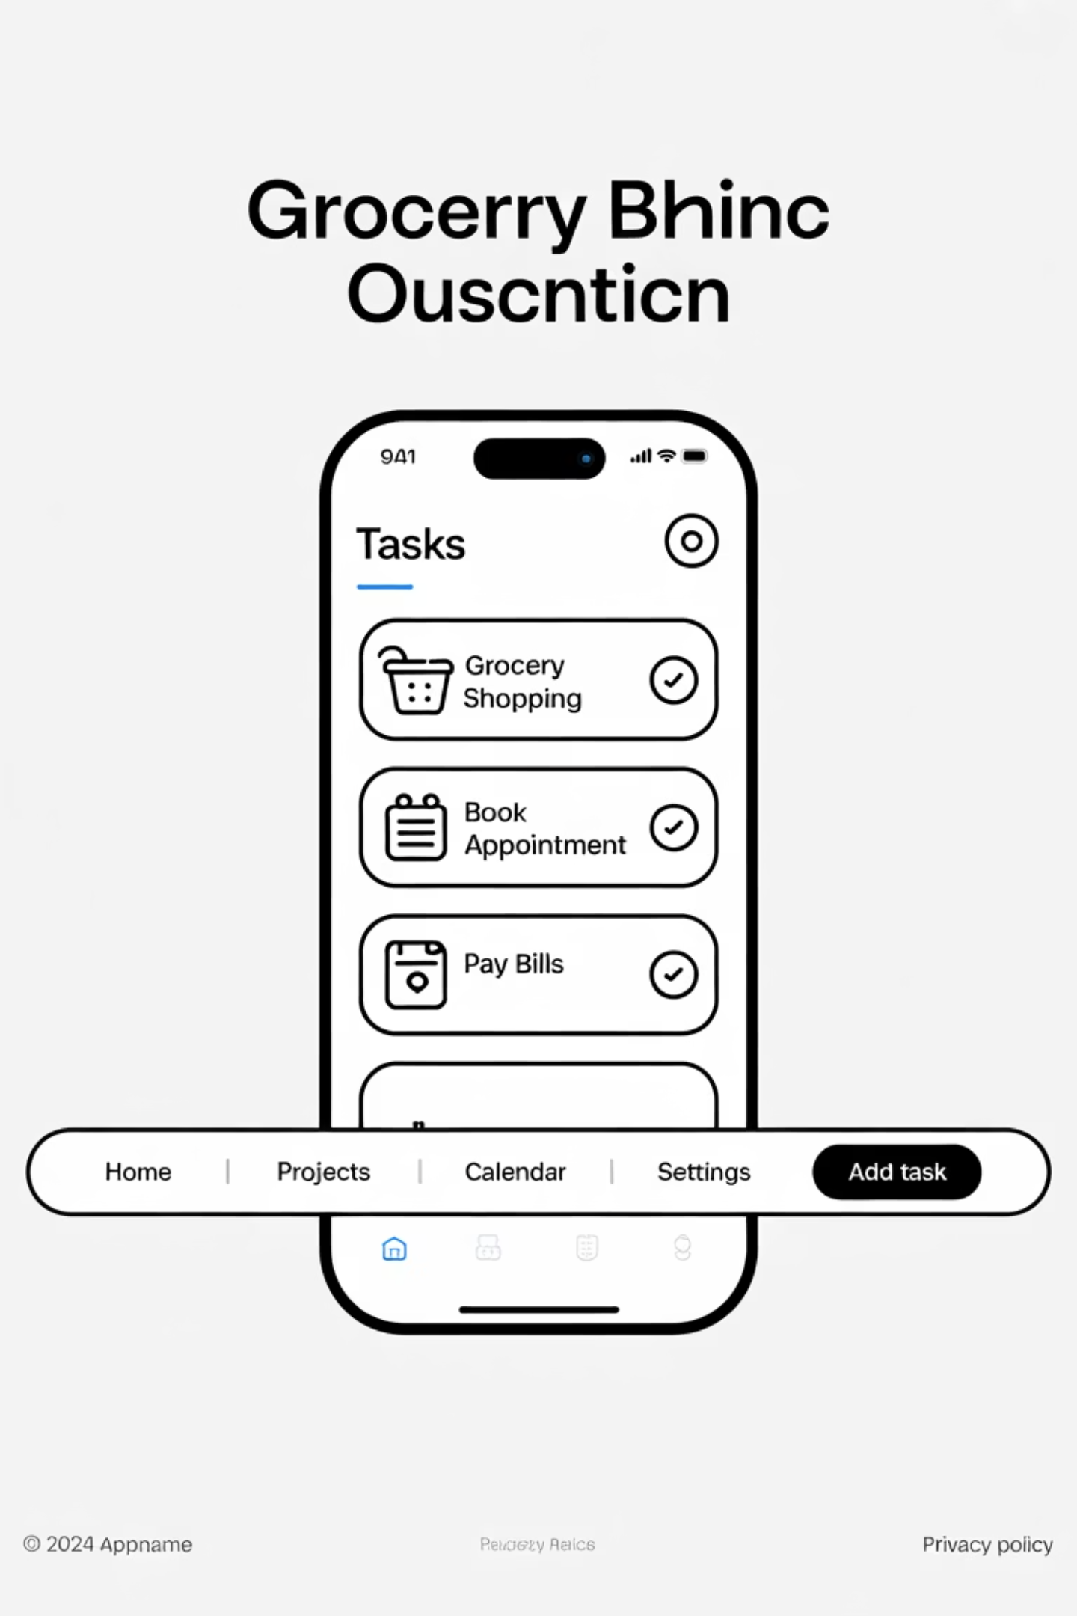
Cupertino Design (Apple's Language)
Born from iOS.
Smooth, elegant, "glass-like" design.
Bottom tabs, sliding navigation, switches.
Flutter Relevance: Flutter provides Cupertino widgets (CupertinoButton, CupertinoSwitch, etc.) to make iOS users feel at home.

Slide 8
Material vs Cupertino (Side by Side)
Feature
Material (Android)
Cupertino (iOS)
Buttons
Bold, filled, flat
Rounded, smooth, elegant
Navigation
Drawer, AppBar
Bottom tab bar, gestures
Animation
Fast, snappy
Smooth, elastic
Story: "I once used Material design on an iOS app. My iPhone-using friend said: 'Bro, this feels like a cheap Android copy.' Never again!"

Slide 9
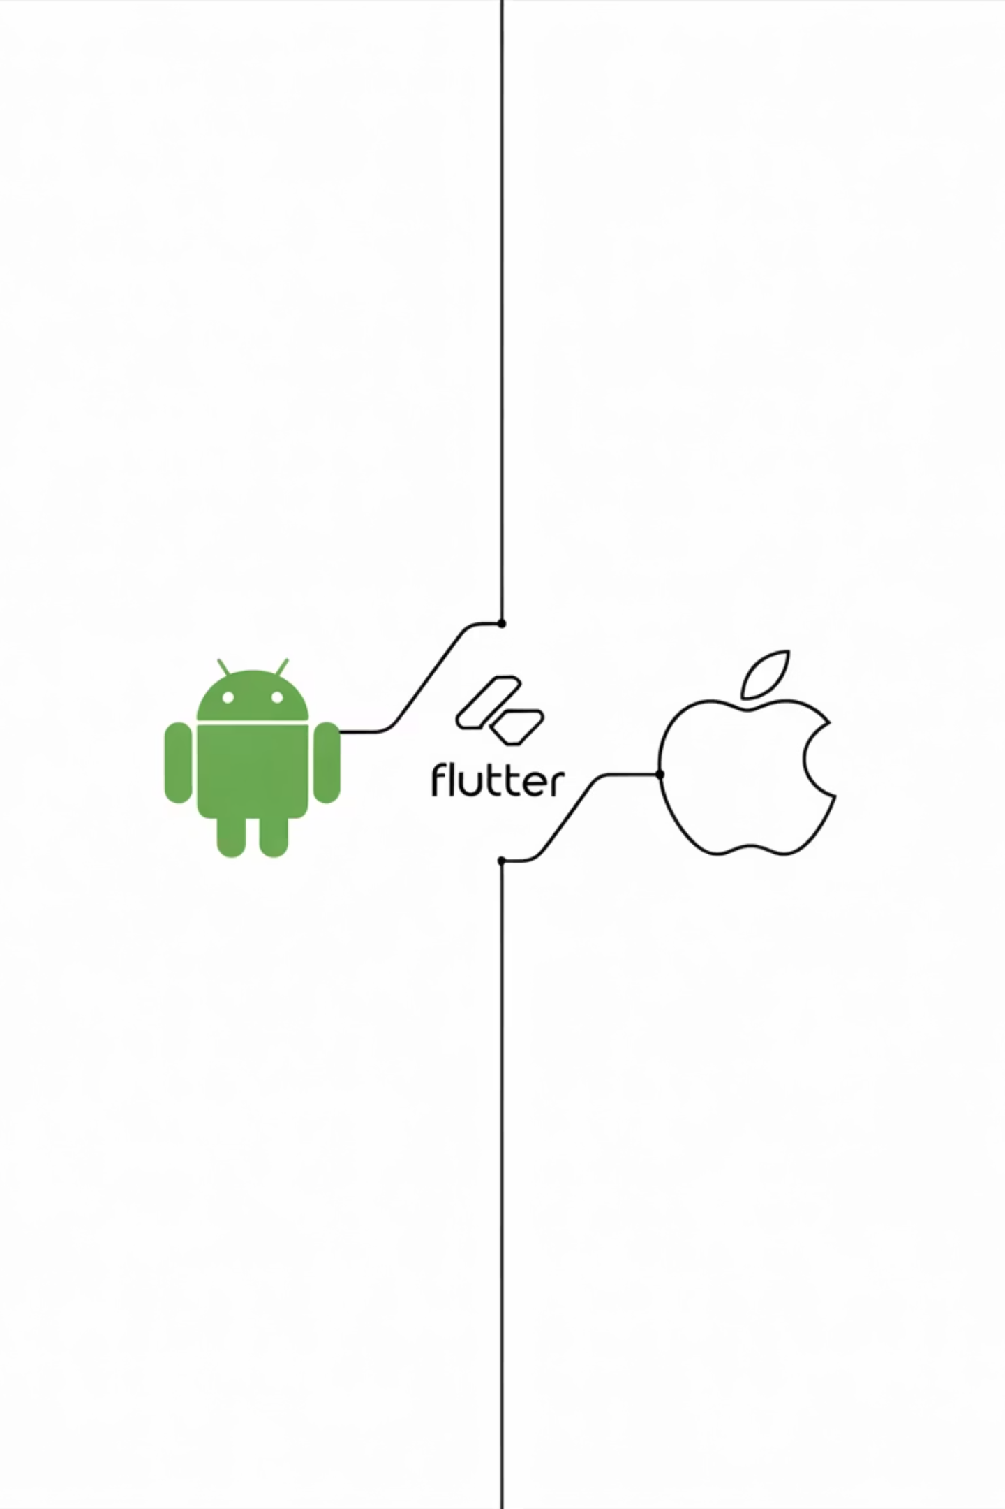
Flutter's Superpower
With Flutter, you can mix & match.
MaterialApp → Android look.
CupertinoApp → iOS look.
Hybrid? Use both in same app!
Interactive: Ask: "If you build a banking app, would you keep Android bold design or iOS elegant look?"

Slide 10
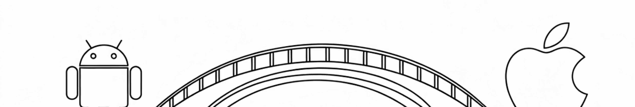
Wrap-Up & Takeaway
Android OS → open, customizable, wide audience.
iOS OS → controlled, premium, strict rules.
Material Design = Android's style.
Cupertino = iOS's style.
As Flutter devs → You're the bridge. One code, two worlds.
Ending Question: "Next time you design a button in Flutter, will you choose Material or Cupertino?" 😉

Slide 11
Students Will Clearly See
Why OS matters (different ecosystems)
Why design languages matter (user expectations)
How Flutter handles both with ease
👉 Students will clearly see:
Why OS matters (different ecosystems).
Why design languages matter (user expectations).
How Flutter handles both with ease.

